Slide 1

Onboard chargers for EVs using Dual Active Bridge and Totem Pole PFC
Group Members:
Anurag Upadhyaya(077BEL007)
Arjun Oli (077BEL010)
Pratik Panuhar (077BEL029)
Rohan (077BEL035)
Submitted to:
Department of Electrical Engineering IOE, Pulchowk Campus
September 2024

Slide 2

Onboard Charging System for Electric Vehicles
Electric Vehicles (EVs) are gaining popularity due to environmental concerns. Onboard charging systems are crucial for EV adoption and convenience. Our project focuses on developing an efficient onboard charging system.
1

Slide 3

Project Objectives
1
To Facilitate Efficient Onboard Charging
Develop an efficient onboard charging system for EVs, optimizing charging speed and minimizing energy loss.
2
To Implement Totem Pole PFC
Implement and analyze Totem Pole Power Factor Correction (PFC) for AC-DC conversion, improving power efficiency and reducing harmonics.
3
To Design Dual Active Bridge Converter
Design a Dual Active Bridge (DAB) converter for DC-DC conversion, enabling bidirectional power flow and supporting vehicle-to-grid applications.
4
To Achieve Advanced Control with FPGA
Utilize FPGA for advanced control mechanisms, enabling faster response times, more complex algorithms, and adaptive control strategies.
2

Slide 4
System Overview
Battery Pack
Electric Motor
Charging System
Stores energy for powering the electric motor.
Converts electrical energy into mechanical energy to propel the vehicle.
Manages the charging process, converting AC power to DC and regulating battery charging.
Thermal Management System
AC-DC Converter
Electric Vehicle Control Unit
Converts grid AC power to DC power for battery charging.
Regulates the temperature of the battery pack and other components to ensure optimal performance and safety.
Manages overall vehicle operation, including powertrain control, charging, and safety systems.
Filters
Reduce electromagnetic interference and noise in the system.
3

Slide 5
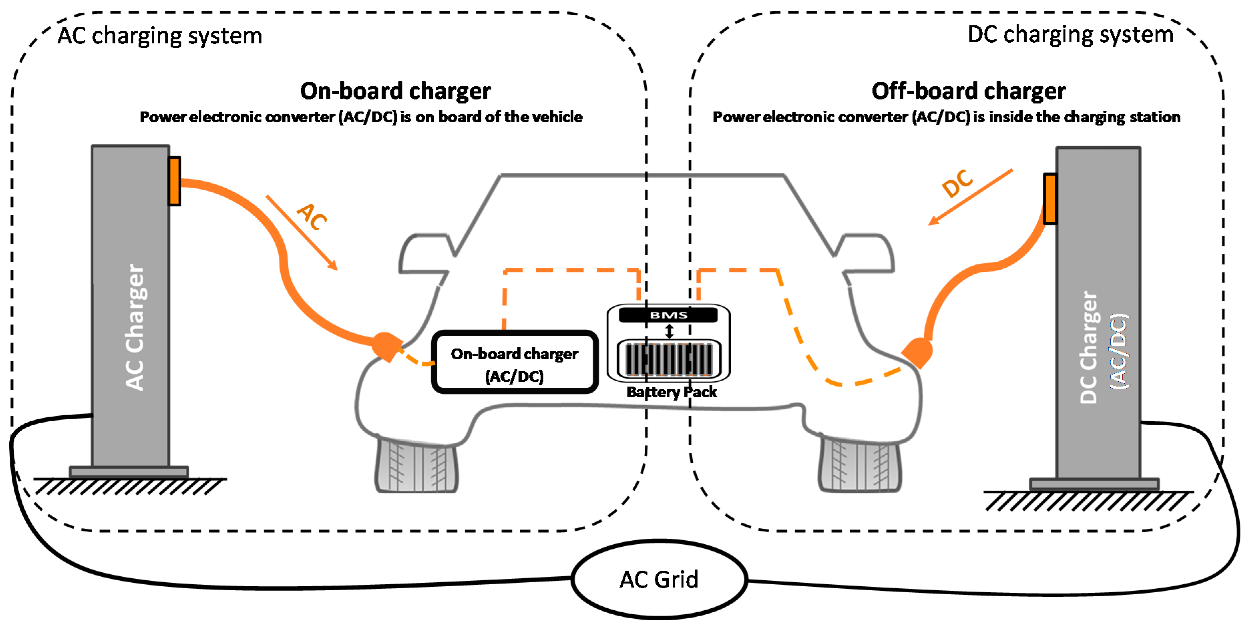
4

Slide 6
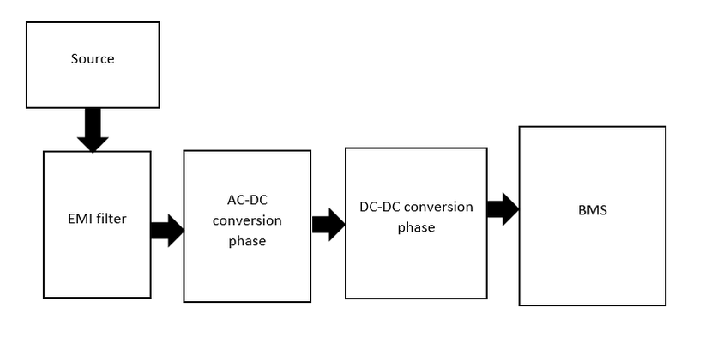
On board charging
A bridge between Electrical Vehicle Supply Equipment(EVSE) and the battery.
Converts alternating current available in the grid to direct current which charges the battery in the vehicle.
Critical component in electric vehicles (EVs), enabling them to charge their batteries from standard electrical outlets or dedicated charging stations.
Fig: General Block Diagram of an OBC
5

Slide 7
Onboard Charging Components
EMI Filter
Power Factor Correction
AC-DC Converter
DC-DC Converter
Reduces electromagnetic interference generated by the switching power electronics, ensuring compliance with electromagnetic compatibility standards.
Converts the grid's AC power to DC power, suitable for charging the battery pack.
Adjusts the voltage levels of the DC power to match the battery's requirements, ensuring efficient and safe charging.
Improves power efficiency by correcting the power factor of the AC input, reducing energy loss and improving grid compatibility.
6

Slide 8
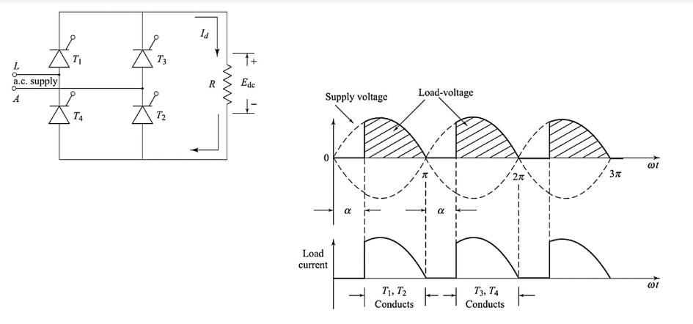
AC-DC Conversion
For onboard charging various types of circuitry have been used, to begin with, we might look at the full-wave controlled rectifier circuit for AC/DC conversion
Major Problem: Pulsating Voltage and Current
7

Slide 9
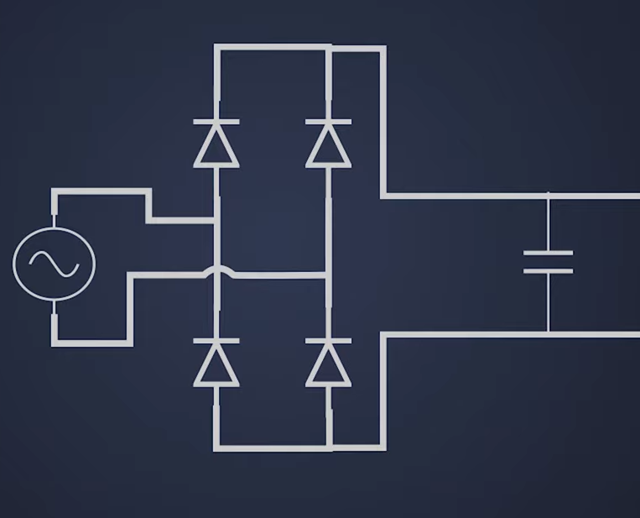
AC-DC Conversion
The ripple/pulse in output voltage can be reduced through a capacitor filter.
Major Problem: Poor Power Factor
8

Slide 10
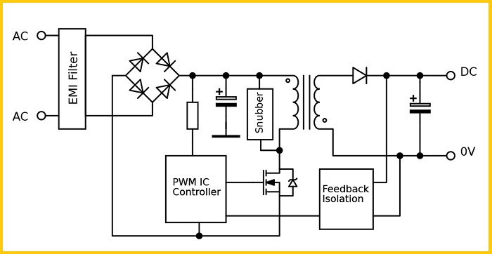
AC-DC Conversion
1
Grid AC to DC Conversion
Critical for converting the grid's AC power to DC power for battery charging.
2
Totem Pole PFC Implementation
We're implementing Totem Pole PFC for improved efficiency, power factor correction, and reduced harmonics.
3
Advantages of Totem Pole PFC
High efficiency, power factor correction, reduced harmonics, and improved grid compatibility.
9

Slide 11
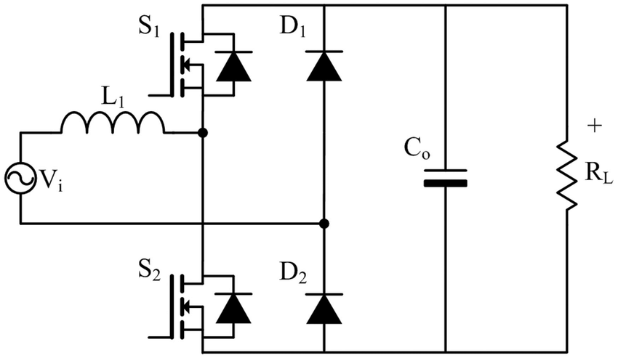
TOTEM POLE PFC
Here, rather than the usual four diodes as a bridge, two active switches are in one leg with the diodes on the other.
It operates in two states:
Zero State
Active State
Fig: A Basic Totem Pole PFC Circuit
10

Slide 12
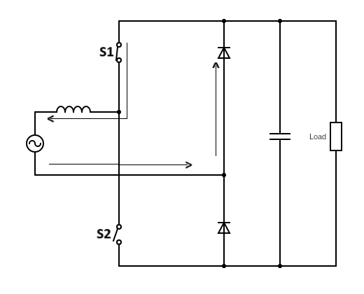
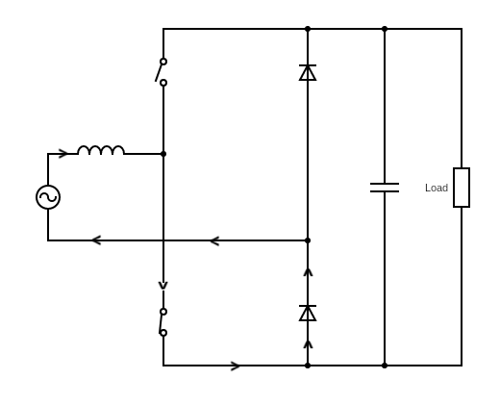
Zero State Operation
During the –ve half cycle
During the +ve half cycle
In this state, the inductor is charged and the capacitor powers the load
11

Slide 13
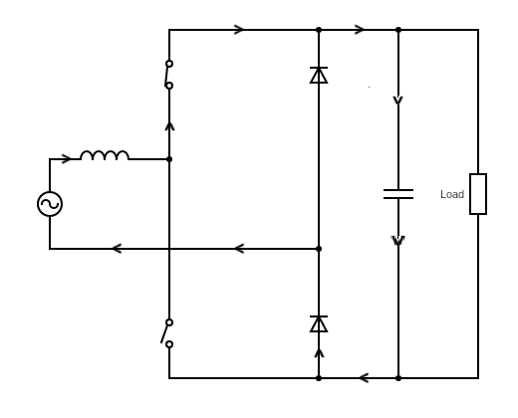
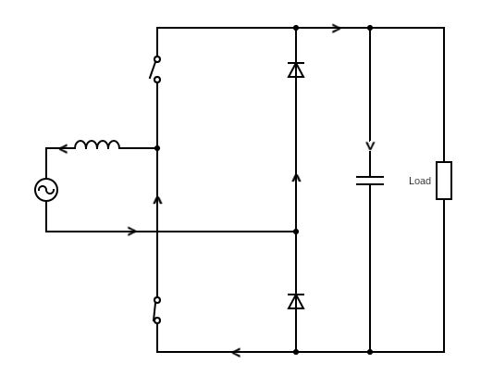
Active State Operation
During the +ve half cycle
During the –ve half cycle
In this state, the inductor is discharged and the capacitor is charged.
12

Slide 14
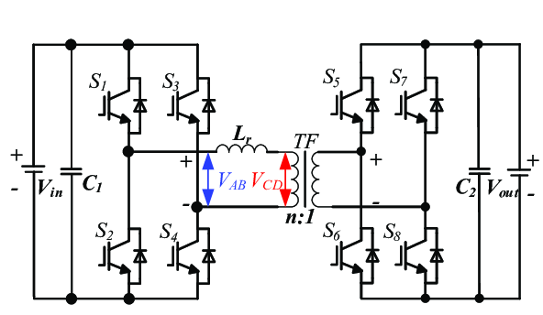
DC-DC Conversion: Introduction
1
Dual Active Bridge (DAB) Converter
Chosen for the DC-DC stage due to its advantages in bidirectional power flow, high efficiency, and compact design.
2
Advantages of DAB Converter
Bidirectional power flow, enabling vehicle-to-grid applications, high efficiency, and compact design.
Fig: DAB Converter Topology
3
Vehicle-to-Grid Applications
Supports potential vehicle-to-grid applications, where the EV can act as a distributed energy storage system, providing power back to the grid.
13

Slide 15
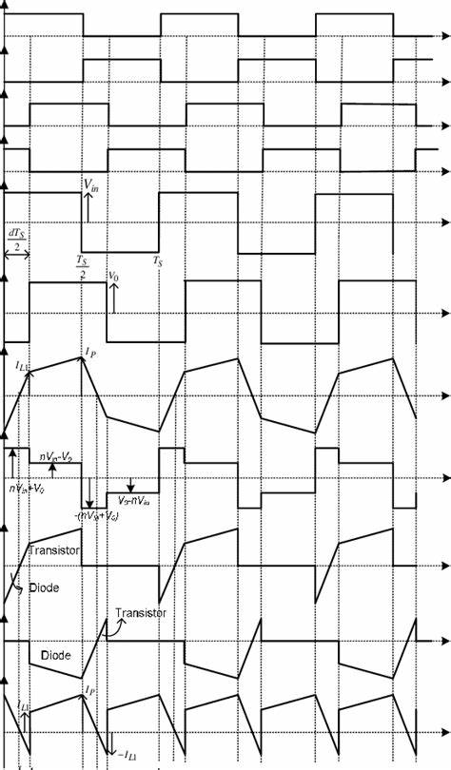
S1
S3
S5
S1,S4 are triggered at first, then at some angle phi S5 is triggered. This is the single phase shift control strategy.
14

Slide 16
METHODOLOGY:
For totem pole pfc:
Vin = 85–265 V
Vout = 400 V
Pout = 2–5 kW
Fline = 50 Hz
Fsw = 40 kHz
Iripple = 0.3
Vripple = 0.01
IL = 2500 0.95×85 = 30.98
Ipeak = IL × 1.30 = 30.98 × 1.3 = 40.27 A
L = Vout/ 4×fsw×Iripple = 400 /4×40×10^3×0.3×43.78 = 1.903 × 10^-4 = 190.3 µH
Cout = Pout / Vout 4Π × Fline × Vripple = 2500 / 400 4Π × 400 × 0.01 × 50 = 2486.71 µF
15

Slide 17
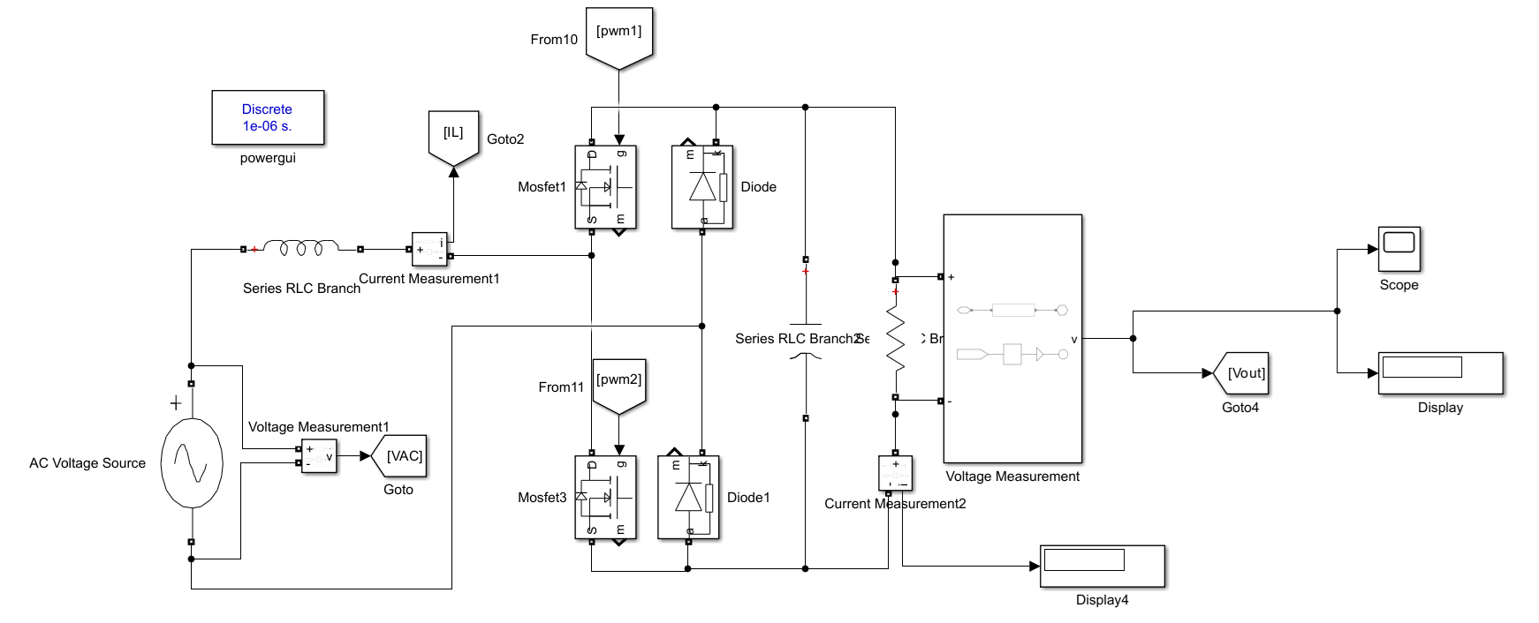
METHODOLOGY:
For totem pole pfc:
Fig: SIMULINK Model for Totem Pole PFC Circuit
16

Slide 18
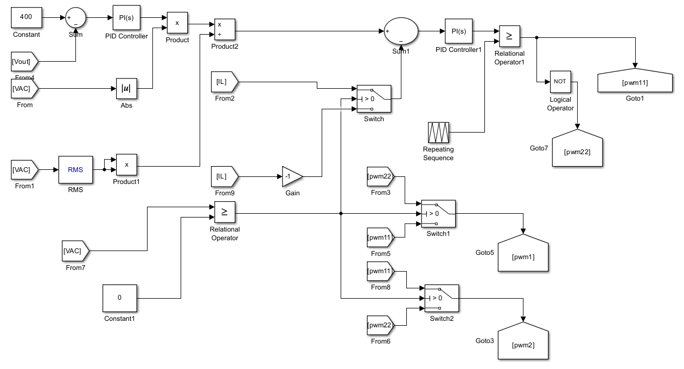
METHODOLOGY:
For totem pole pfc:
Fig: SIMULINK Model for Closed Loop Control of Totem Pole PFC Circuit
17

Slide 19
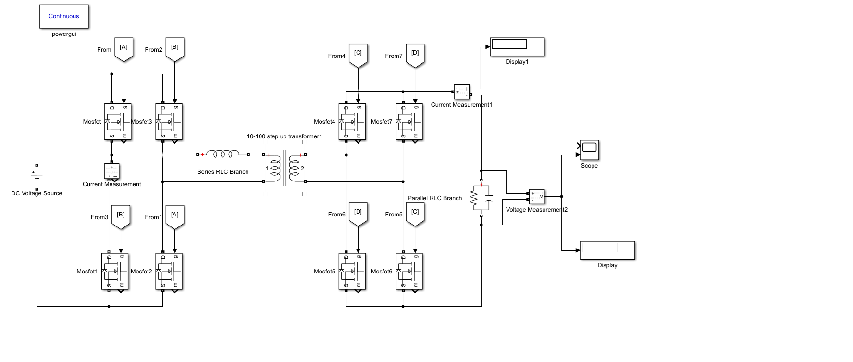
METHODOLOGY:
For DAB Converter:
We know,
Po = Vi² · dΦ / Xl(1 – Φ / Π)
Po = 2500
Vi = 400
Put L = 0.3 × 10^-6 H
d = Vo / nVi
n = ½
For Vo = 200 V
Vi = 400 V
d = 2 × 200 / 400
d = 1
2500 = 400² / 2Π × f × 0.3 × 10^-6 · Φ(1 – Φ / Π)
Also, f = 500 kHz = 500 × 10³
2500 = 169765.2726 Φ(1 – Φ / Π)
0.0463 = ΠΦ – Φ²
Φ² – ΠΦ + 0.0463 = 0
Φ = 3.13 ,0.0148(in radian)
Φ =179.33, 0.85(in degree)
Since,-90<phi<90
So,
Φ=0.85
Fig: SIMULINK Model for Dual Active Bridge (DAB) Converter
18

Slide 20
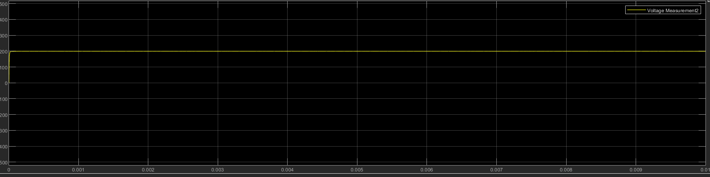
Results and analysis:
For output=200V and Power,P=2.5kW
For dc/dc conversion circuit:
Iout=12.31A
Vout=199.2V
Pout=Iout*Vout
=12.31*199.2
=2452W
Efficiency_1=(2452)/2500
=98.08%
Graph for Vout:
19

Slide 21
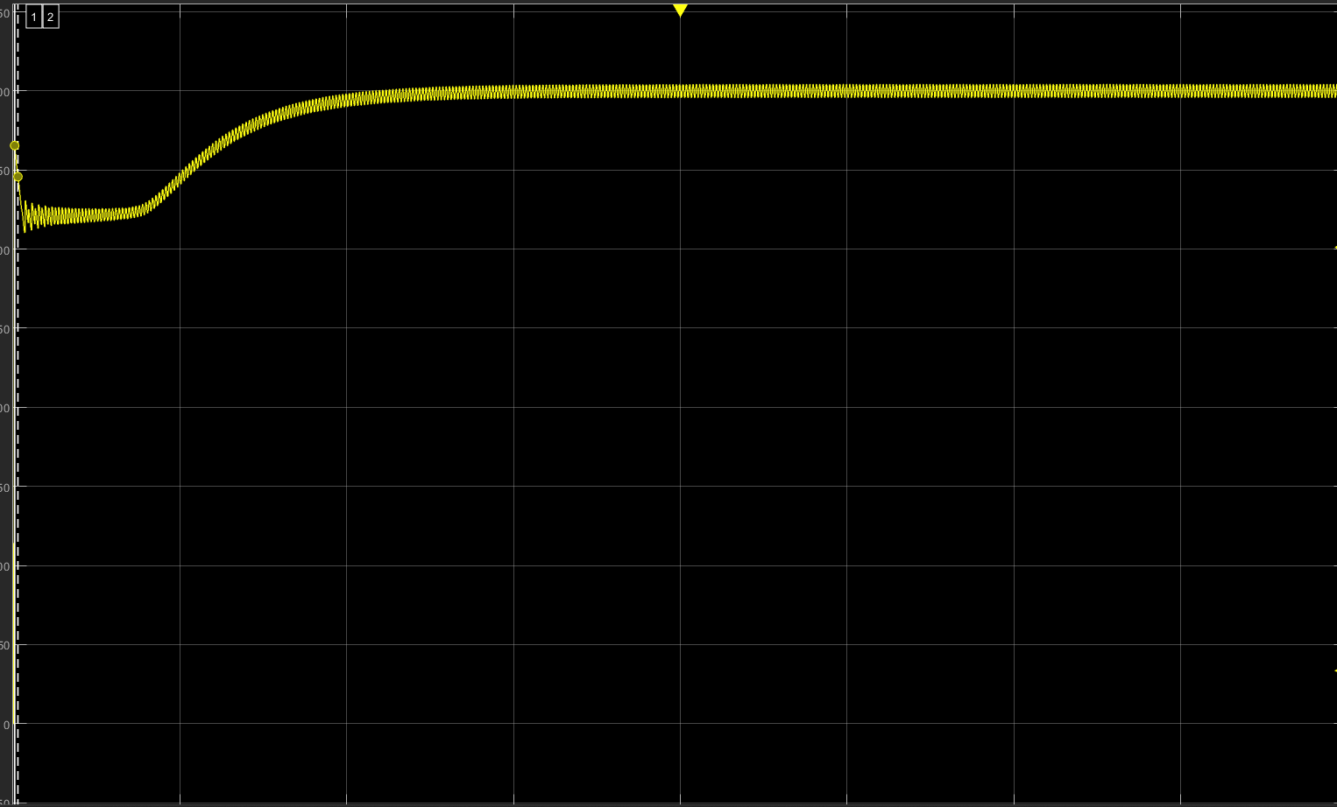
For rectification circuit:
For output=400V and Power,P=2.5kW
Iout=6.249A
Vout=399.9V
Pout=Iout*Vout
=2499
Efficiency_2=(2499)/2500
=99.96%
Limitation: Although both stages of the onboard charging circuit have high efficiency when isolated, the overall efficiency of the system is likely to decrease when both circuits are connected. This contributes to the ongoing discussion in the EV field regarding research of single-stage OBC to improve efficiency and compactness.
20

Slide 22
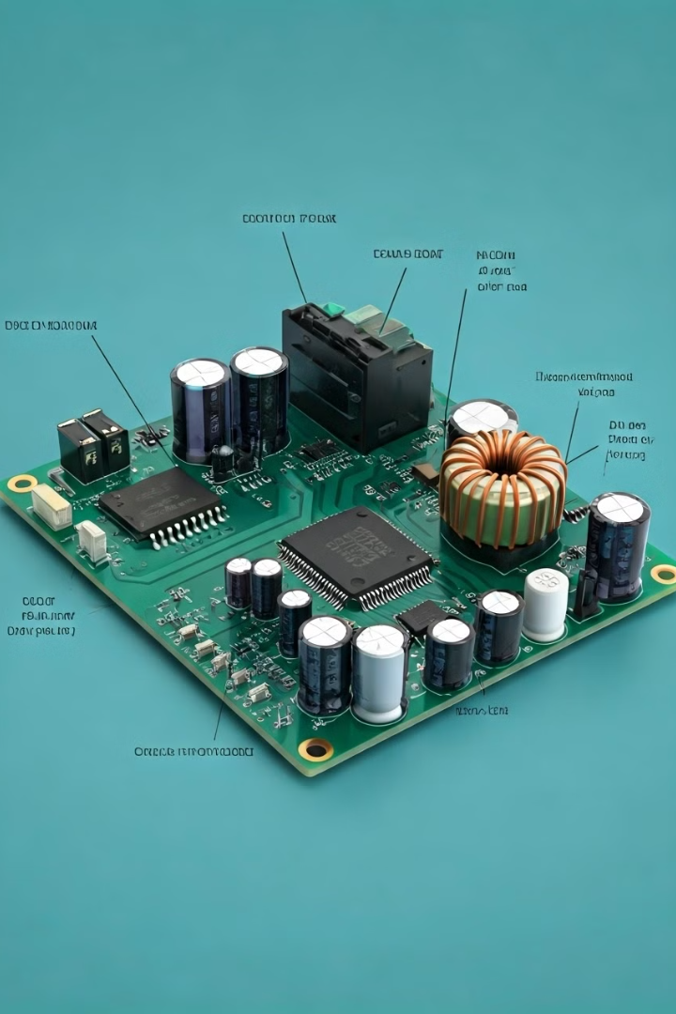
Future Implementation Plans
1
Optimize Totem Pole PFC to reduce output ripple
2
Fine-tune DAB converter performance
3
Implement and test Microcontroller-based control system
21

Slide 23

Project Timeline
1
Completed
Literature review, system design, Totem Pole PFC and DAB implementation
2
In Progress
PFC and DAB optimization, Micro controller hardware selection
3
Next
Microcontroller implementation, system integration
4
Future
Comprehensive testing, performance analysis, and potential enhancements
22

Slide 24
Challenges and Learning Outcomes
Challenges
Learning Outcomes
Dealing with high-frequency switching noise
Balancing efficiency and output quality in both Totem Pole PFC and DAB Converter
Ensuring robust operation under various conditions.
Deeper understanding of power electronics in EV applications
Practical experience with PFC and DAB circuit design and implementation
and improved problem-solving skills in real-world engineering scenarios.
23

Slide 25
Conclusion
Successfully implemented Totem Pole PFC with 400V output
Achieved implementation of DAB converter with the output voltage 200V
Laid groundwork for micro-controller based control system
The project aims to contribute to more efficient EV charging systems
Potential impact: Faster charging times, improved grid integration for EVs
24

Slide 26

Any Questions?
Thank you for your attention. We welcome any questions or feedback on our progress so far.

